Slide 1
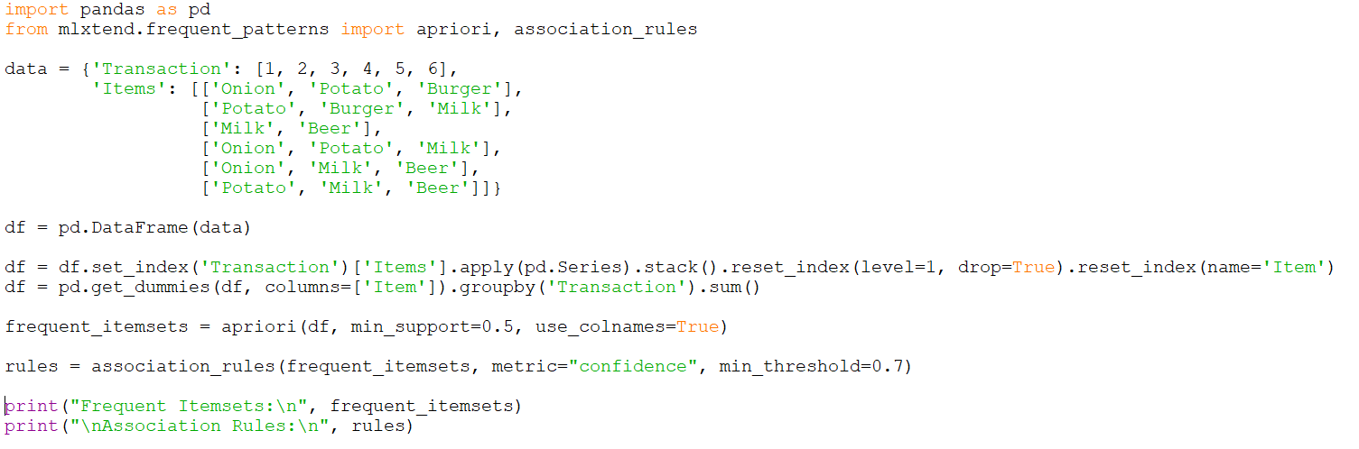

Program
Importing Libraries
Sample Data set
Convert Dataset to DataFrame
Apply Apriori Algorithm
Generate Association Rules

Slide 2
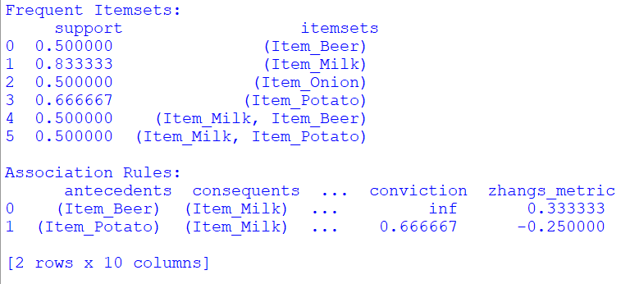
Output

